Slide 1
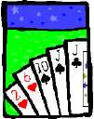
Basic Counting

Slide 2
This Lecture
We will study some basic rules for counting.
Sum rule, product rule, generalized product rule
Permutations, combinations
Binomial coefficients, combinatorial proof
Inclusion-exclusion principle

Slide 3
Sum Rule
|S|: the number of elements in a set S.
A
B
If sets A and B are disjoint, then
|A ∪ B| = |A| + |B|

Slide 4
Sum Rule
A
B
If sets A and B are disjoint, then
|A ∪ B| = |A| + |B|
Class has 43 women, 54 men, so total enrollment = 43 + 54 = 97
26 lower case letters, 26 upper case letters, and 10 digits,
so total characters = 26+26+10 = 62

Slide 5
Product Rule
Recall that, given two sets A and B, the Cartisean product
Fact: If |A| = n and |B| = m, then |AxB| = mn.
A = {a, b, c, d}, B = {1, 2, 3}
A × B = {(a,1),(a,2),(a,3),
(b,1),(b,2),(b,3),
(c,1),(c,2),(c,3),
(d,1),(d,2),(d,3) }
Example: If there are 4 men and 3 women, there are
possible married couples.

Slide 6
Product Rule
Fact: If |A| = n and |B| = m, then |AxB| = mn.
In general let A = {a₁, a₂, a₃, …, a_{m}} and B = {b₁, b₂, …, b_{n}}.
We can arrange the elements into a table as follows.
A × B = {(a₁,b₁), (a₁,b₂),…, (a₁,b_{n}),
(a₂,b₁), (a₂,b₂),…, (a₂,b_{n}),
(a₃,b₁), (a₃,b₂),…, (a₃,b_{n}),
…
(a_{m},b₁), (a_{m},b₂),…, (a_{m},b_{n}), }
There are m rows, and each row has n elements,
and so there are a total of mn elements.

Slide 7
Product Rule
Fact: |A₁xA₂x…xA_{k}| = |A₁|x|A₂|x…x|A_{k}|.
The formal proof uses mathematical induction.
But the proof idea is not difficult.
We think of A₁xA₂x…xA_{k} as (…((A₁xA₂)xA₃)…xA_{k}).
That is, we first construct A₁xA₂, and it is a set of size |A₁|x|A₂|.
Then, we construct (A₁xA₂)xA₃, the product of A₁xA₂ and A₃,
and it is a set of size (|A₁|x|A₂|)x|A₃| by the product rule on two sets.
Repeating the argument we can see that |A₁xA₂x…xA_{k}| = |A₁|x|A₂|x…x|A_{k}|.

Slide 8
Example: Counting Strings
Let B={0,1}.
The set of 2-bit strings is just BxB.
The set of 10-bit strings is just BxBxBxBxBxBxBxBxBxB, denoted by B¹⁰.
By the product rule, |BxB| = |B|x|B| = 2x2 = 4, and
|B¹⁰| = |B|x|B|x|B|x|B|x|B|x|B|x|B|x|B|x|B|x|B| = |B|¹⁰ = 2¹⁰ = 1024.
What is the number of 10-bit strings?

Slide 9
Example: IP Addresses
What is the number of IP addresses?
An IP address is of the form 192.168.0.123.
There are four numbers, each is between 0 and 255.
Let B={0,1,…,255}.
Then the set of IP addresses is just B⁴.
By the product rule, |B⁴| = |B|⁴ = 256⁴ = 4294967296.

Slide 10
Example: Product Rule
In general we have:
m^{n}.
The number of length-n strings from an alphabet of size m is
That is, |B^{n}| = |B|^{n}.
e.g. the number of length-n binary strings is 2^{n}
the number of length-n strings formed by capital letters is 26^{n}

Slide 11
Example: Counting Passwords
How many passwords satisfy the following requirements?
between 6 & 8 characters long
starts with a letter
case sensitive
other characters: digits or letters
First we define the set of letters and the set of digits.
L = {a,b,…,z,A,B,…,Z}
D = {0,1,…,9}

Slide 12
Example: Counting Passwords
L ::= {a,b,…,z,A,B,…,Z}
D ::= {0,1,…,9}
We first count the number of passwords with a specific length.
Let P_{n} be the set of passwords with length n.
P₆ =

Slide 13
Example: Counting Passwords
by product rule
by sum rule
The set of Passwords:
counting by partitioning
This is a common technique.
Divide the set into disjoint subsets.
Count each subset and add the answers.

Slide 14
At Least One Seven
How many # 4-digit numbers with at least one 7?
count by 1st occurrence of 7:
7xxx + o7xx + oo7x + ooo7
where x represents any digit from 1 to 10,
while o represent any digit from 1 to 10 except 7.
Clearly, each number containing at least one 7 is in
one of the above sets, and these sets are disjoint.
Therefore, the answer to the question is:
10³ + 9·10² + 9²·10 + 9³ = 3439
Method 1:
The set of 4-digit
numbers with 7 in
the first digit.
The set of 4-digit
numbers with 7 in
the second digit,
but the first digit
is not 7, and so on.
(counting by partitioning)

Slide 15
At Least One Seven
How many # 4-digit numbers with at least one 7?
Method 2:
|4-digit numbers with at least one 7|=
|4-digit numbers| − |those with no 7s|
= 10⁴ – 9⁴
= 3439
(counting the complement)
Counting the complement is a useful technique.

Slide 16
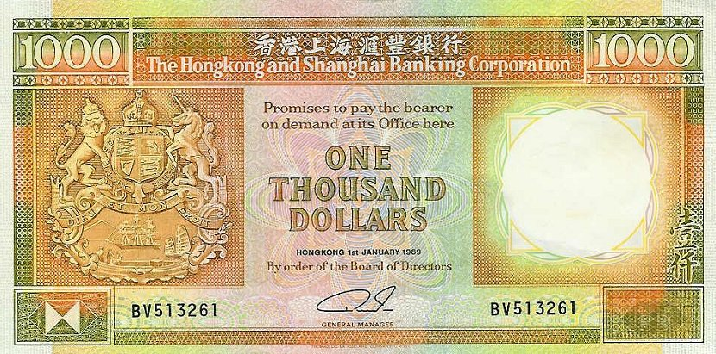
Defective Dollars
A dollar is defective if some digit appears
more than once in the 6-digit serial number.
How common are nondefective dollars?

Slide 17
Defective Dollars
How common are nondefective dollars?
10 possible choices for the first digit,
9 possible choices for the second digit, and so on…
So, there are 10x9x8x7x6x5
= 151200 serial number with all its digit different
There are totally 10⁶ = 1000000 serial numbers.
So, only about 15% of dollars are nondefective.

Slide 18
Generalized Product Rule
Q a set of length-k sequences. If there are:
n₁ possible 1st elements in sequences,
n₂ possible 2nd elements for each first entry,
n₃ possible 3rd elements for each 1st & 2nd,
…
then,
|Q| = n₁ · n₂ · n₃ · … · n_{k}

Slide 19
Counting Passwords
Combining the sum and product rule allows us to solve more complex problems.
Example: Each user on a computer system has a password, which is six to eight characters long, where each character is an uppercase letter or a digit. Each password must contain at least one digit. How many possible passwords are there?
Solution: Let P be the total number of passwords, and let P₆, P₇, and P₈ be the passwords of length 6, 7, and 8.
By the sum rule P = P₆ + P₇ +P₈.
To find each of P₆, P₇, and P₈ , we find the number of passwords of the specified length composed of letters and digits and subtract the number composed only of letters. We find that:
P₆ = 36⁶ − 26⁶ =2,176,782,336 − 308,915,776 =1,867,866,560.
P₇ = 36⁷ − 26⁷ =
78,364,164,096 − 8,031,810,176 = 70,332,353,920.
P₈ = 36⁸ − 26⁸ =
2,821,109,907,456 − 208,827,064,576 =2,612,282,842,880.
Consequently, P = P₆ + P₇ +P₈ = 2,684,483,063,360.

Slide 20
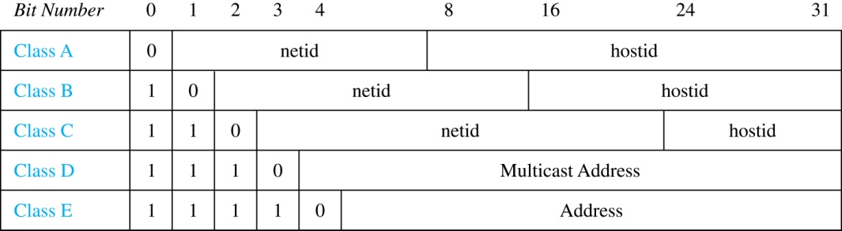
Internet Addresses
Version 4 of the Internet Protocol (IPv4) uses 32 bits.
Class A Addresses: used for the largest networks, a 0,followed by a 7-bit netid and a 24-bit hostid.
Class B Addresses: used for the medium-sized networks, a 10,followed by a 14-bit netid and a 16-bit hostid.
Class C Addresses: used for the smallest networks, a 110,followed by a 21-bit netid and a 8-bit hostid.
Neither Class D nor Class E addresses are assigned as the address of a computer on the internet. Only Classes A, B, and C are available.
1111111 is not available as the netid of a Class A network.
Hostids consisting of all 0s and all 1s are not available in any network.

Slide 21
Counting Internet Addresses
Example: How many different IPv4 addresses are available for computers on the internet?
Solution: Use both the sum and the product rule. Let x be the number of available addresses, and let x_{A}, x_{B}, and x_{C} denote the number of addresses for the respective classes.
To find, x_{A}: 2⁷ − 1 = 127 netids. 2²⁴ − 2 = 16,777,214 hostids.
x_{A} = 127∙ 16,777,214 = 2,130,706,178.
To find, x_{B}: 2¹⁴ = 16,384 netids. 2¹⁶ − 2 = 16,534 hostids.
x_{B} = 16,384 ∙ 16, 534 = 1,073,709,056.
To find, x_{C}: 2²¹ = 2,097,152 netids. 2⁸ − 2 = 254 hostids.
x_{C} = 2,097,152 ∙ 254 = 532,676,608.
Hence, the total number of available IPv4 addresses is
x = x_{A} + x_{B} + x_{C}
= 2,130,706,178 + 1,073,709,056 + 532,676,608
= 3, 737,091,842.

Slide 22
Basic Counting Principles: Subtraction Rule
Subtraction Rule: If a task can be done either in one of n₁ ways or in one of n₂ ways, then the total number of ways to do the task is n₁ + n₂ minus the number of ways to do the task that are common to the two different ways.
Also known as, the principle of inclusion-exclusion:

Slide 23
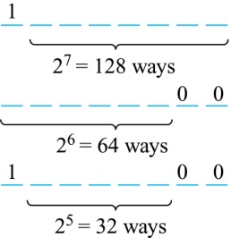
Counting Bit Strings
Example: How many bit strings of length eight either start with a 1 bit or end with the two bits 00?
Solution: Use the subtraction rule.
Number of bit strings of length eight that start with a 1 bit: 2⁷ = 128
Number of bit strings of length eight that start with bits 00: 2⁶ = 64
Number of bit strings of length eight that start with a 1 bit and end with bits 00 : 2⁵ = 32
Hence, the number is 128 + 64 − 32 = 160.

Slide 24
Basic Counting Principles: Division Rule
Division Rule: There are n/d ways to do a task if it can be done using a procedure that can be carried out in n ways, and for every way w, exactly d of the n ways correspond to way w.
Restated in terms of sets: If the finite set A is the union of n pairwise disjoint subsets each with d elements, then n = |A|/d.
In terms of functions: If f is a function from A to B, where both are finite sets, and for every value y ∈ B there are exactly d values x ∈ A such that f(x) = y, then |B| = |A|/d.
Example: How many ways are there to seat four people around a circular table, where two seatings are considered the same when each person has the same left and right neighbor?
Solution: Number the seats around the table from 1 to 4 proceeding clockwise. There are four ways to select the person for seat 1, 3 for seat 2, 2, for seat 3, and one way for seat 4. Thus there are 4! = 24 ways to order the four people. But since two seatings are the same when each person has the same left and right neighbor, for every choice for seat 1, we get the same seating.
Therefore, by the division rule, there are 24/4 = 6 different seating arrangements.

Slide 25
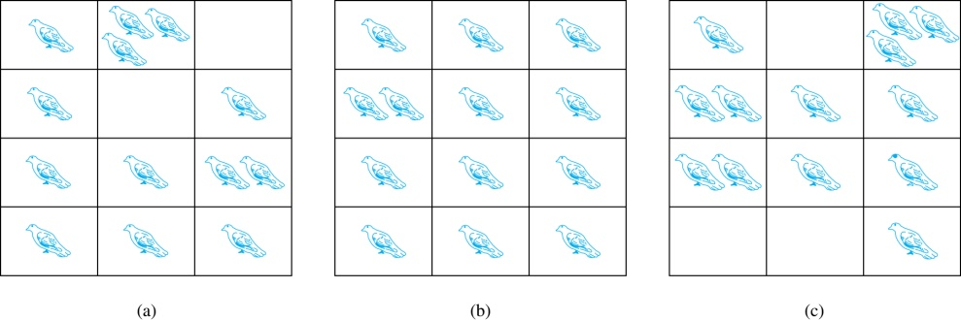
The Pigeonhole Principle
Suppose a flock of pigeons fly into a set of pigeonholes to roost.
If there are more pigeons than pigeonholes then there must be at least 1 pigeonhole that has more than one pigeon on it.
If a flock of 20 pigeons roosts in a set of 19 pigeonholes, one of the pigeonholes must have more than 1 pigeon.
Pigeonhole Principle: If k is a positive integer and k + 1 objects are placed into k boxes, then at least one box contains two or more objects.
In a group of 367 people there must be two people with the same birthday
There are 366 possible birthdays

Slide 26
The Pigeonhole Principle
Corollary 1: A function f from a set with k + 1 elements to a set with k elements is not one-to-one.
Proof: Use the pigeonhole principle.
Create a box for each element y in the codomain of f .
Put in the box for y all of the elements x from the domain such that f(x) = y.
Because there are k + 1 elements and only k boxes, at least one box has two or more elements.
Hence, f can’t be one-to-one.

Slide 27
The Generalized Pigeonhole Principle
The Generalized Pigeonhole Principle: If N objects are placed into k boxes, then there is at least one box containing at least ⌈N/k⌉ objects.
The ceiling function tells us to round up to the nearest whole integer.
Example: Among 100 people what is the number of people that must be born on the same month?
there are at least ⌈100/12⌉ = 9 who were born in the same month.

Slide 28
Pigeonhole Principle
Example: Among any group of 367 people, there must be at least two with the same birthday, because there are only 366 possible birthdays.
⌈367/365⌉ = 2
In a group of 27 English words, atleast two words must start with the same letter.
There are only 26 letters
⌈27/26⌉= 2

Slide 29
The Generalized Pigeonhole Principle
Example: a) How many cards must be selected from a standard deck of 52 cards to guarantee that at least three cards of the same suit are chosen?
Solution: a) We assume four boxes; one for each suit. Using the generalized pigeonhole principle, at least one box contains at least ⌈N/4⌉ cards. At least three cards of one suit are selected if ⌈N/4⌉ ≥3. The smallest integer N such that ⌈N/4⌉ ≥3 is N = 2 ∙ 4 + 1 = 9.

Slide 30
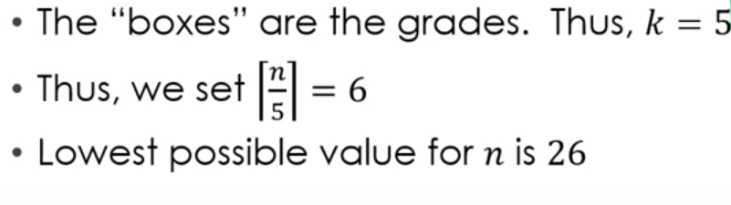
How many students in a class must there be to ensure that 6 students get the same grade (one of A, B, C, D or F)?

Slide 31
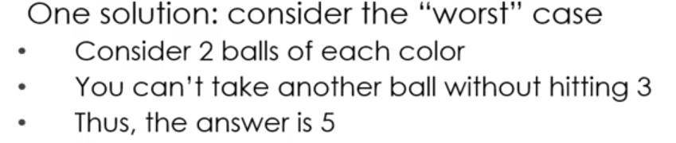
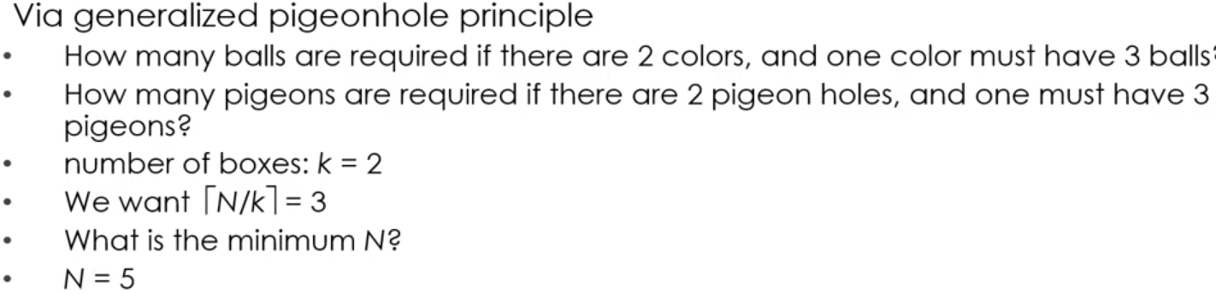
A bowl contains 10 red and 10 yellow balls
A) How many balls must be selected to ensure 3 balls of the same color

Slide 32


What’s the minimum number of students, each of whom comes from one of the 50 states must be enrolled in a university to guarantee that there at least 100 who come from the same state?
There are 38 different time periods during which classes at a university can be scheduled. If there are 677 different classes, how many different rooms will be needed?

Slide 33
This Lecture
Sum rule, product rule, generalized product rule
Permutations, combinations
Binomial coefficients, combinatorial proof
Inclusion-exclusion principle

Slide 34
Permutations
Definition: A permutation of a set S is a sequence that
contains every element of S exactly once.
For example, here are all six permutations of the set {a, b, c}:
(a, b, c) (a, c, b) (b, a, c)
(b, c, a) (c, a, b) (c, b, a)
Ordering is important here.
How many permutations of an n-element set are there?
You can think of a permutation as a ranking of the elements.
So the above question is asking how many rankings of an n-element set.

Slide 35
Permutations
How many permutations of an n-element set are there?
There are n choices for the first element.
For each of these, there are n − 1 remaining choices for
the second element.
For every combination of the first two elements, there
are n − 2 ways to choose the third element, and so forth.
Thus, there are a total of
n · (n − 1) · (n − 2) · · · 3 · 2 · 1 = n!
permutations of an n-element set.
This is called n factorial.
Stirling’s formula (optional):

Slide 36
Example: Permutation
Suppose each digit is an element in {1,2,3,4,5,6,7,8,9}.
How many 9-digit numbers are there where each nonzero digit appears once?
Each such number corresponds to a permutation of 123456789,
and each permutation corresponds to such a number.
So the numbers of such numbers is equal to
the number of permutations of {1,2,3,4,5,6,7,8,9}.
Hence there are exactly 9! such numbers.
Alternatively, one can use the generalized product rule
directly to obtain the same result.

Slide 37
Combinations
How many subsets of size k of an n-element set?
Consider the set {1,2,3,4,5} where n=5.
If k=2, then there are 10 possible subsets of size 2,
i.e. {1,2}, {1,3}, {1,4}, {1,5}, {2,3}, {2,4}, {2,5}, {3,4}, {3,5}, {4,5}.
If k=3, then there are also 10 possible subsets of size 3,
i.e. {1,2,3}, {1,2,4}, {1,2,5}, {1,3,4}, {1,3,5}
{1,4,5}, {2,3,4}, {2,3,5}, {2,4,5}, {3,4,5}
Ordering is NOT important here.

Slide 38
Combinations
How many subsets of size k of an n-element set?
There are n choices for the first element.
For each of these, there are n − 1 remaining choices for
the second element.
There are n – k + 1 remaining choices for the last element.
Thus, there are a total of
n · (n − 1) · (n − 2) · · · (n – k + 1) to choose k elements.
So far we counted the number of ways to choose k elements,
when the ordering is important.
e.g. {1,2,3}, {1,3,2}, {2,1,3}, {2,3,1}, {3,1,2}, {3,2,1} will be counted as 6 different ways.

Slide 39
Combinations
How many subsets of size k of an n-element set?
We form the subsets by picking one element at a time.
There are n choices for the first element.
For each of these, there are n − 1 remaining choices for
the second element.
There are n – k + 1 remaining choices for the last element.
Thus, there are a total of
n · (n − 1) · (n − 2) · · · (n – k + 1) to choose k elements.
So far we counted the number of ways to choose k elements,
when the ordering is important.

Slide 40
Combinations
How many subsets of size k of an n-element set?
Thus, there are a total of
n · (n − 1) · (n − 2) · · · (n – k + 1) ways to choose k elements,
when the ordering is important.
How many different ordering of k elements are (over)-counted?
e.g. If we are forming subsets of size 3, then
(1,2,3), (1,3,2), (2,1,3), (2,3,1), (3,1,2), (3,2,1)
are counted as 6 different ways if the ordering is important.
In general, each subset of size k has k! different orderings,
and so each subset is counted k! times in the above way of choosing k elements.

Slide 41
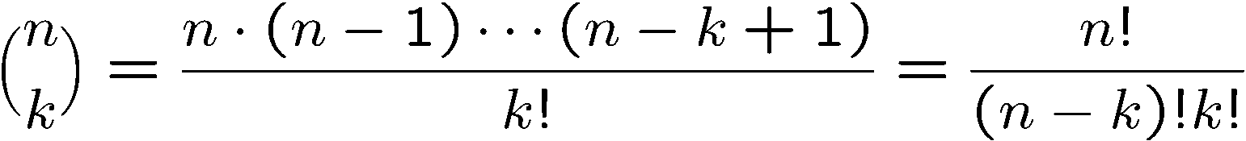
Combinations
How many subsets of size k of an n-element set?
Thus, there are a total of
n · (n − 1) · (n − 2) · · · (n – k + 1) ways to choose k elements,
when the ordering is important.
Each subset is counted, but is counted k! times, because
each subset contributes k! different orderings to the above.
So, when the ordering is not important, the answer is:
This is the
shorthand for
“n choose k”

Slide 42
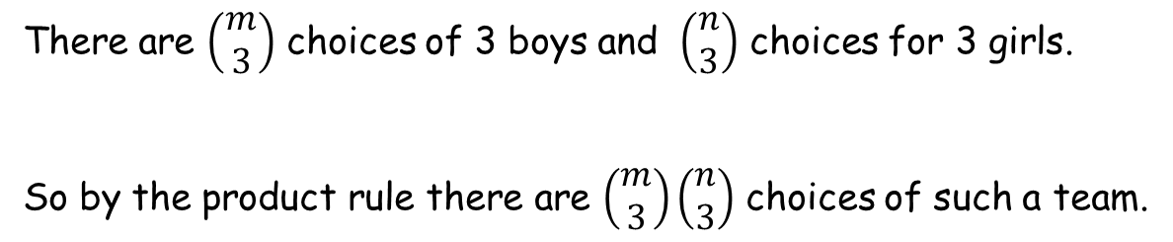
Example: Team Formation
There are m boys and n girls.
How many ways are there to form a team with 3 boys and 3 girls?
There are $\left(\begin{matrix}m \\ 3\end{matrix}\right)$ choices of 3 boys and $\left(\begin{matrix}n \\ 3\end{matrix}\right)$ choices for 3 girls.
So by the product rule there are $\left(\begin{matrix}m \\ 3\end{matrix}\right)\left(\begin{matrix}n \\ 3\end{matrix}\right)$ choices of such a team.
If m < 3 or n < 3, then the answer should be zero.
Don’t worry. We don’t like to trick you this way.

Slide 43
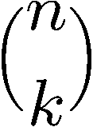
Example: Bit Strings with k Zeros
How many n-bit sequences contain k zeros and (n − k) ones?
We can think of this problem as choosing k positions
(out of the n possible positions) and set them to zeroes
and set the remaining positions to ones.
So the above question is asking the number of
possible positions of the k zeros, and the answer is:

Slide 44
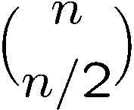
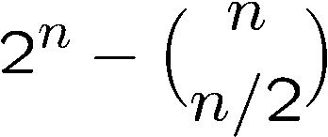
Example: Unbalanced Bit Strings
We say a bit string is unbalanced if there are
more ones than zeroes or more zeros than ones.
How many n-bit strings are unbalanced?
If n is odd, then every n-bit string is unbalanced, and the answer is 2^{n}.
If n is even, then the number of balanced strings is
by choosing n/2 positions to zeroes.
So the number of unbalanced n-bit strings is equal to
the number of all n-bit strings minus the number of balanced strings,
and so the answer is
(counting the complement)

Slide 45
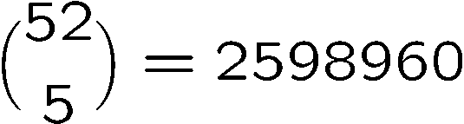
Poker Hands
There are 52 cards in a deck.
Each card has a suit and a value.
(♠ ♥ ♦ ♣)
4 suits
13 values
(2, 3, 4, 5, 6, 7, 8, 9, 10, J, Q, K, A)
Five-Card Draw is a card game in which each player
is initially dealt a hand, a subset of 5 cards.
How many different hands?

Slide 46
Example 1: Four of a Kind
A Four-of-a-Kind is a set of four cards with the same value.
How many different hands contain a Four-of-a-Kind?
One way to do this is to first map the problem into
a problem of counting sequences.

Slide 47

Example 1: Four of a Kind
A hand with a Four-of-a-Kind is completely described by a sequence specifying:
1. The value of the four cards.
2. The value of the extra card.
3. The suit of the extra card.
There are 13 choices for (1), 12 choices for (2), and 4 choices for (3).
By generalized product rule, there are 13x12x4 = 624 hands.
Only 1 hand in about 4165 has a Four-of-a-Kind!

Slide 48
Example 2: Full House
A Full House is a hand with three cards of one value and two cards of another value.
How many different hands contain a Full House?

Slide 49
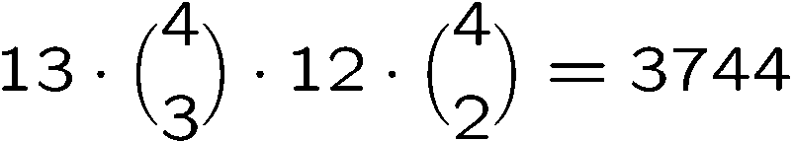
Example 2: Full House
There is a bijection between Full Houses and sequences specifying:
1. The value of the triple, which can be chosen in 13 ways.
2. The suits of the triple, which can be selected in (4 3) ways.
3. The value of the pair, which can be chosen in 12 ways.
4. The suits of the pair, which can be selected in (4 2) ways.
By generalized product rule, there are
Only 1 hand in about 634 has a Full House!

Slide 50

Example 3: Two Pairs
How many hands have Two Pairs; that is,
two cards of one value, two cards of another value, and one card of a third value?

Slide 51
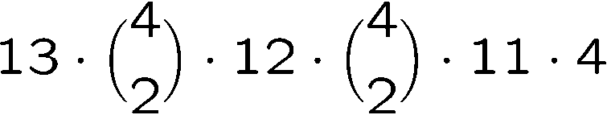
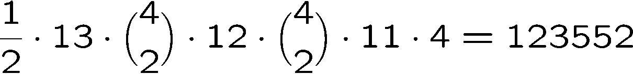
Example 3: Two Pairs
1. The value of the first pair, which can be chosen in 13 ways.
2. The suits of the first pair, which can be selected (4 2) ways.
3. The value of the second pair, which can be chosen in 12 ways.
4. The suits of the second pair, which can be selected in (4 2) ways
5. The value of the extra card, which can be chosen in 11 ways.
6. The suit of the extra card, which can be selected in 4 ways.
Number of Two pairs =
Double
Count!
So the answer is

Slide 52

Example 4: Every Suit
How many hands contain at least one card from every suit?
1. The value of each suit, which can be selected in 13x13x13x13 ways.
2. The suit of the extra card, which can be selected in 4 ways.
3. The value of the extra card, which can be selected in 12 ways.
Double count!
So the answer is 13⁴x4x12/2 = 685464

Slide 53
This Lecture
Sum rule, product rule, generalized product rule
Permutations, combinations
Binomial coefficients, combinatorial proof
Inclusion-exclusion principle

Slide 54
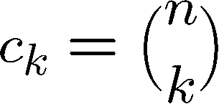
Binomial Theorem
We can compute the coefficients by simple counting arguments.
n times
Each term corresponds to selecting 1 or x from each of the n factors.
c_{k} is number of terms with exactly k x’s are selected from n factors.

Slide 55
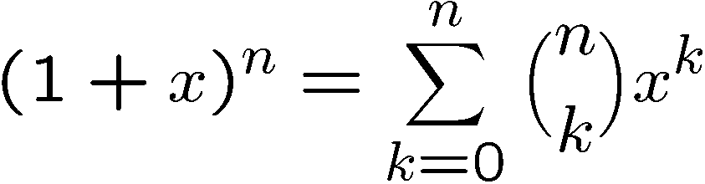
Binomial Theorem
(1+X)⁰ =
1
(1+X)¹ =
1 + 1X
(1+X)² =
1 + 2X + 1X²
(1+X)³ =
1 + 3X + 3X² + 1X³
(1+X)⁴ =
1 + 4X + 6X² + 4X³ + 1X⁴

Slide 56
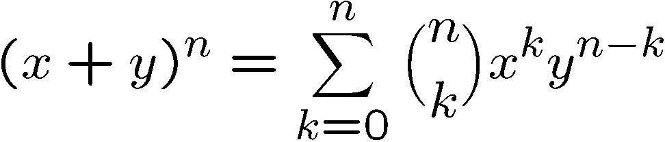
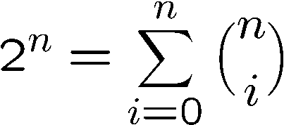
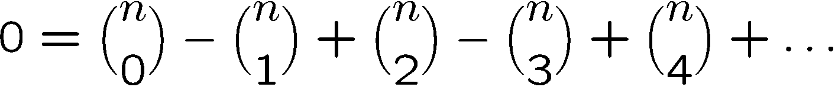
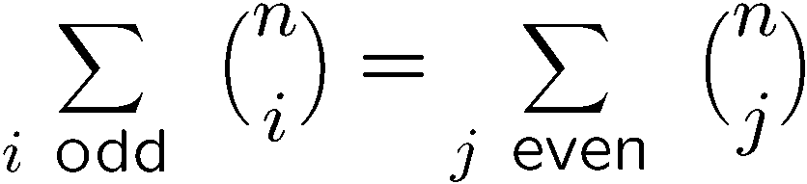
Binomial Coefficients
In general we have the following identity:
When x=1, y=1, it says that
When x=1, y=-1, it says that

Slide 57
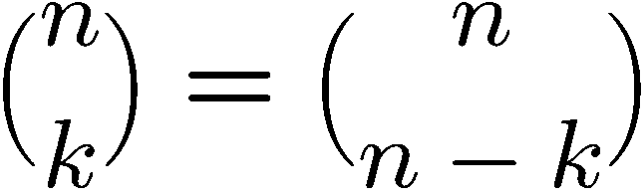
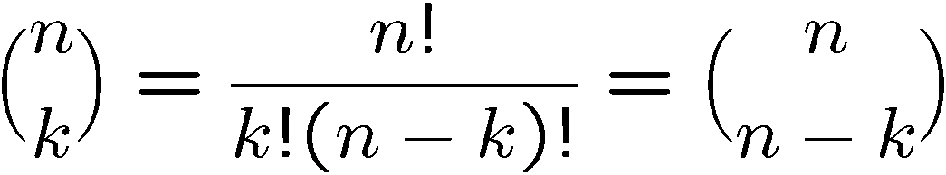
Proving Identities
Direct proof:
Combinatorial proof:
Number of ways to choose k items from n items
= number of ways to choose n-k items from n items

Slide 58
Finding a Combinatorial Proof
A combinatorial proof is an argument that establishes an algebraic fact by relying on counting principles.
Many such proofs follow the same basic outline:
1. Define a set S.
2. Show that |S| = n by counting one way.
3. Show that |S| = m by counting another way.
4. Conclude that n = m.
Double counting

Slide 59
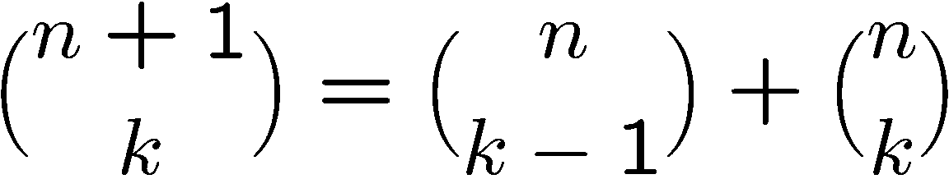
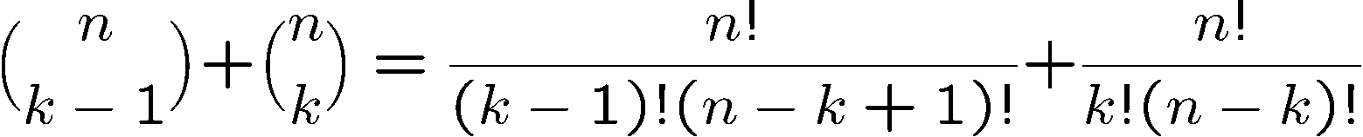
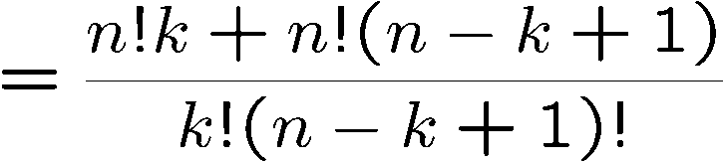
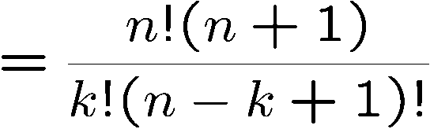
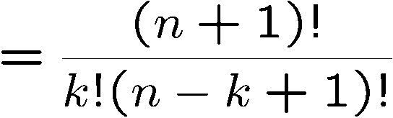
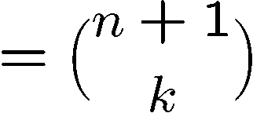
Proving Identities
Pascal’s Formula
Direct proof:
Direct proof:

Slide 60
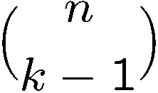

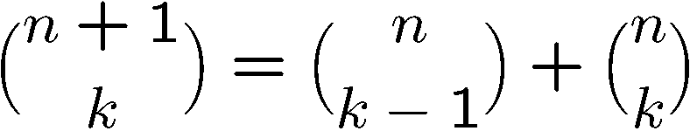
Proving Identities
Pascal’s Formula
Combinatorial proof:
The LHS is number of ways to choose k elements from n+1 elements.
Let the first element be x.
If we choose x, then we need to choose k-1 elements
from the remaining n elements, and number of ways to do so is
If we don’t choose x, then we need to choose k elements
from the remaining n elements, and number of ways to do so is
This partitions the ways to choose k elements from n+1 elements,
therefore

Slide 61
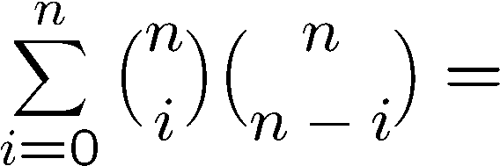
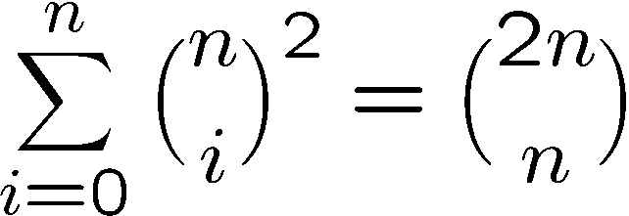
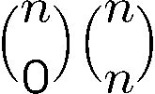
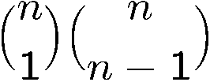
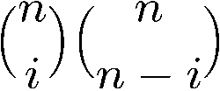
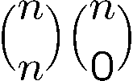
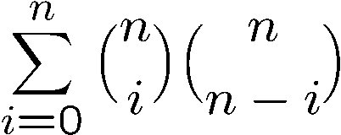
Combinatorial Proof
Consider we have 2n balls, n of them are red, and n of them are blue.
The RHS is number of ways to choose n balls from the 2n balls.
To choose n balls, we can
- choose 0 red ball and n blue balls, number of ways =
- choose 1 red ball and n-1 blue balls, number of ways =
…
choose i red balls and n-i blue balls, number of ways =
…
choose n red balls and 0 blue ball, number of ways =
Hence number of ways to choose n balls is also equal to

Slide 62
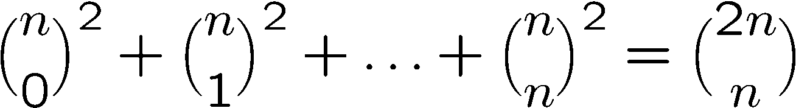
Another Way to Combinatorial Proof (Optional)
We can also prove the identity by comparing a coefficient of two polynomials.
Consider the identity
Consider the coefficient of x^{n} in these two polynomials.
Clearly the coefficient of x^{n} in (1+x)^{2n} is equal to the RHS.
So the coefficient of x^{n} in (1+x)^{n}(1+x)^{n} is equal to the LHS.

Slide 63
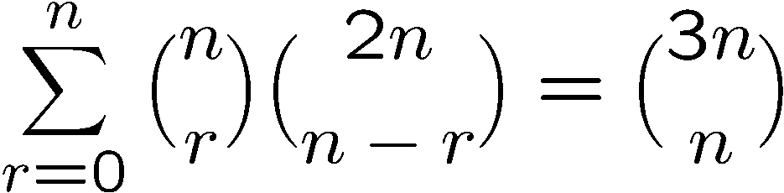
More Combinatorial Proof
Let S be all n-card hands that can be dealt from a deck containing
n red cards (numbered 1, . . . , n) and 2n black cards (numbered 1, . . . , 2n).
The right hand side = # of ways to choose n cards from these 3n cards.
The left hand side = # of ways to choose r cards from red cards x
# of ways to choose n-r cards from black cards
= # of ways to choose n cards from these 3n cards
= the right hand side.

Slide 64


Powers of Binomial Expressions
Definition: A binomial expression is the sum of two terms, such as x + y. (More generally, these terms can be products of constants and variables.)
We can use counting principles to find the coefficients in the expansion of (x + y)^{n} where n is a positive integer.
To illustrate this idea, we first look at the process of expanding (x + y)³.
(x + y) (x + y) (x + y) expands into a sum of terms that are the product of a term from each of the three sums.
Terms of the form x³, x²y, x y², y³ arise. The question is what are the coefficients?
To obtain x³ , an x must be chosen from each of the sums. There is only one way to do this. So, the coefficient of x³ is 1.
To obtain x²y, an x must be chosen from two of the sums and a y from the other. There are ways to do this and so the coefficient of x²y is 3.
To obtain xy², an x must be chosen from of the sums and a y from the other two . There are ways to do this and so the coefficient of xy² is 3.
To obtain y³ , a y must be chosen from each of the sums. There is only one way to do this. So, the coefficient of y³ is 1.
We have used a counting argument to show that (x + y)³ = x³ + 3x²y + 3x y² + y³ .
Next we present the binomial theorem gives the coefficients of the terms in the expansion of (x + y)^{n} .

Slide 65


Binomial Theorem
Binomial Theorem: Let x and y be variables, and n a nonnegative integer. Then:
Proof: We use combinatorial reasoning . The terms in the expansion of (x + y)^{n} are of the form x^{n−j}y^{j} for j = 0,1,2,…,n. To form the term x^{n−j}y^{j}, it is necessary to choose (n−j) xs from the n sums. Therefore, the coefficient of x^{n−j}y^{j} is which equals .

Slide 66
Using the Binomial Theorem
Example: What is the coefficient of x¹²y¹³ in the expansion of (2x − 3y)²⁵?

Slide 67
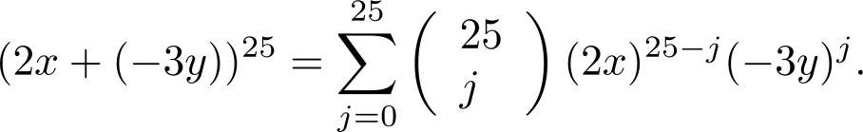
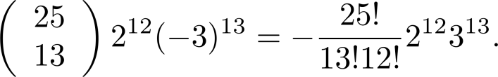
Using the Binomial Theorem
Example: What is the coefficient of x¹²y¹³ in the expansion of (2x − 3y)²⁵?
Solution: We view the expression as (2x +(−3y))²⁵. By the binomial theorem
Consequently, the coefficient of x¹²y¹³ in the expansion is obtained when j = 13.

Slide 68
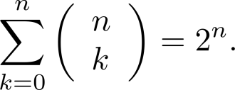
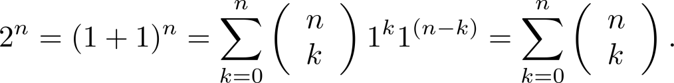
A Useful Identity
Corollary 1: If n ≥0,
Proof (using binomial theorem): With x = 1 and y = 1, from the binomial theorem we see that:

Slide 69
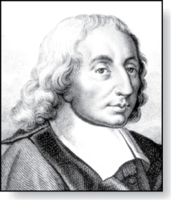
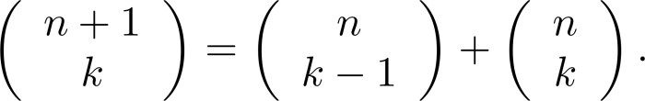
Pascal’s Identity
Blaise Pascal
(1623-1662)
Pascal’s Identity: If n and k are integers with n ≥ k ≥ 0, then

Slide 70
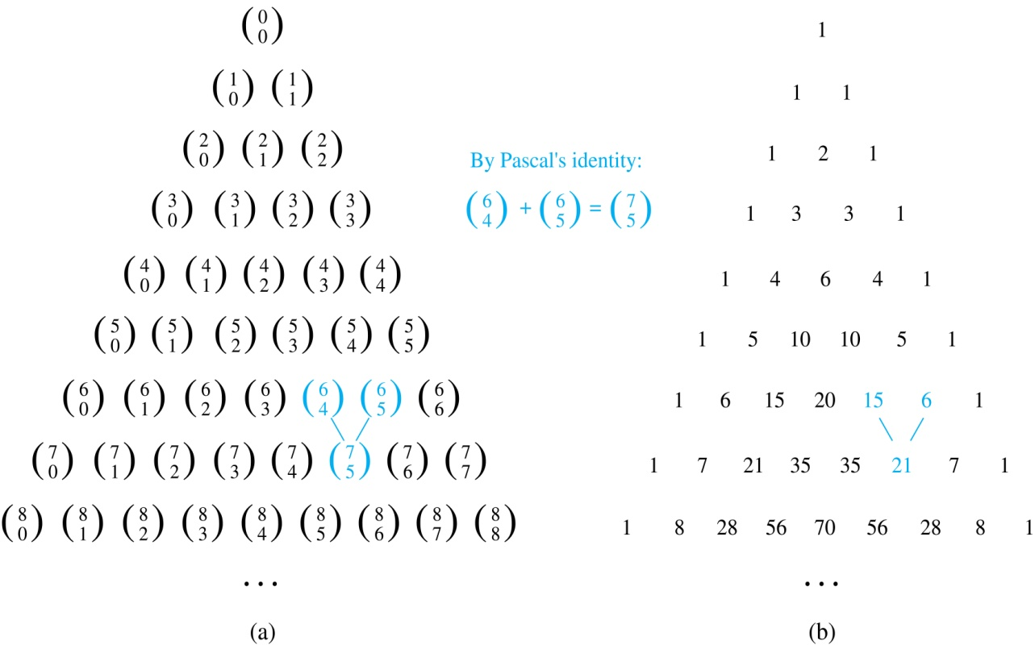

Pascal’s Triangle
The nth row in the triangle consists of the binomial coefficients ,
k = 0,1,….,n.
By Pascal’s identity, adding two adjacent bionomial coefficients results is the binomial coefficient in the next row between these two coefficients.

Slide 71
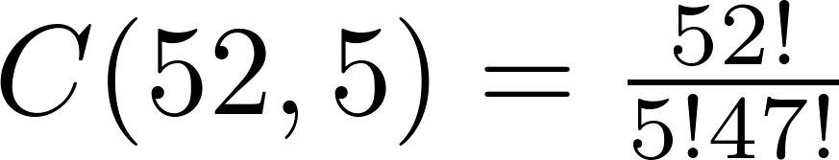
Combinations
Example: How many poker hands of five cards can be dealt from a standard deck of 52 cards? Also, how many ways are there to select 47 cards from a deck of 52 cards?
Solution: Since the order in which the cards are dealt does not matter, the number of five card hands is:
The different ways to select 47 cards from 52 is
This is a special case of a general result. →

Slide 72
Combinations
Example: How many ways are there to select five players from a 10-member tennis team to make a trip to a match at another school.
Example: A group of 30 people have been trained as astronauts to go on the first mission to Mars. How many ways are there to select a crew of six people to go on this mission?

Slide 73

Combinations
Example: How many ways are there to select five players from a 10-member tennis team to make a trip to a match at another school.
Solution: By Theorem 2, the number of combinations is
Example: A group of 30 people have been trained as astronauts to go on the first mission to Mars. How many ways are there to select a crew of six people to go on this mission?
Solution: By Theorem 2, the number of possible crews is

Slide 74
Exercises
Prove that
Give a combinatorial proof of the following identify.
Can you give a direct proof of it?

Slide 75
Quick Summary
We have studied how to determine the size of a set directly.
The basic rules are the sum rule, product rule, and the generalized product rule.
We apply these rules in counting permutations and combinations,
which are then used to count other objects like poker hands.
Then we prove the binomial theorem and study combinatorial proofs of identities.
Finally we learn the inclusion-exclusion principle and see some applications.
Later we will learn how to count “indirectly” by “mapping”.

